Slide 1
TABLEAU
Presnted by → hrithik jagwani

Slide 2
1. Find the sales for every year.
2. Find year for highest sales and lowest sales respectively.
3. show the view in bar graph.
4. Add label to your view.
5. Find the category wise sales for every year.
6. Which category has highest sales in the year 2020 & 2021.
7. Based on the analysis of the year 2020 & 2021. give some suggestions to improve Sales in the year 2022.
8. Display subcategory and find some insights from the view about max and min sales under every category.
9. Change the color of your visual.
10. Check the Tooltip.
11. In your bar graph, present subcategory under each bar of category using colour card

Slide 3
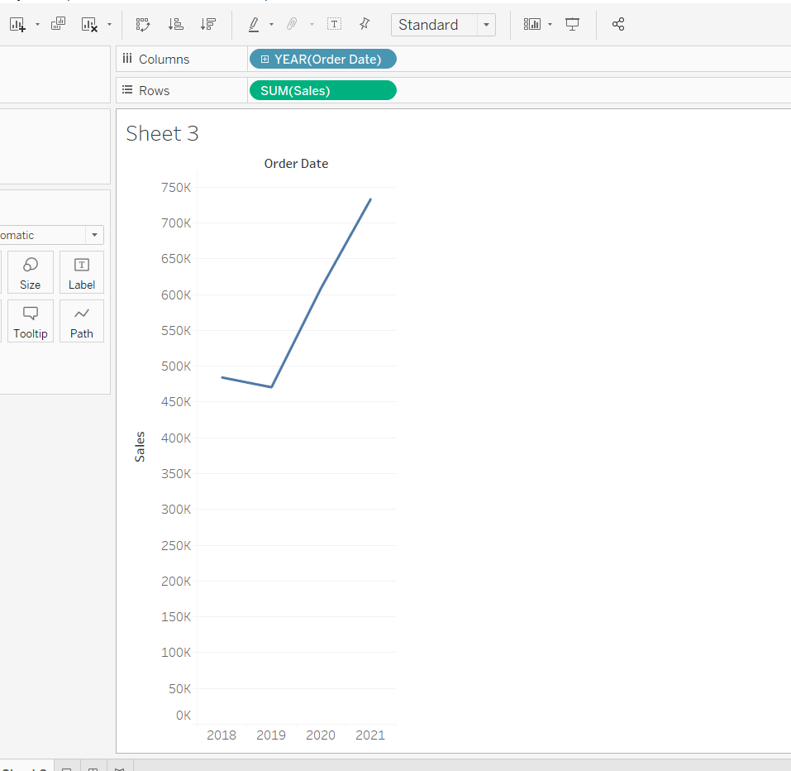
1. Find the sales for every year.

Slide 4
2. Find year for highest sales and lowest sales respectively.
Highest sales → 2021
Lowest sales → 2019

Slide 5
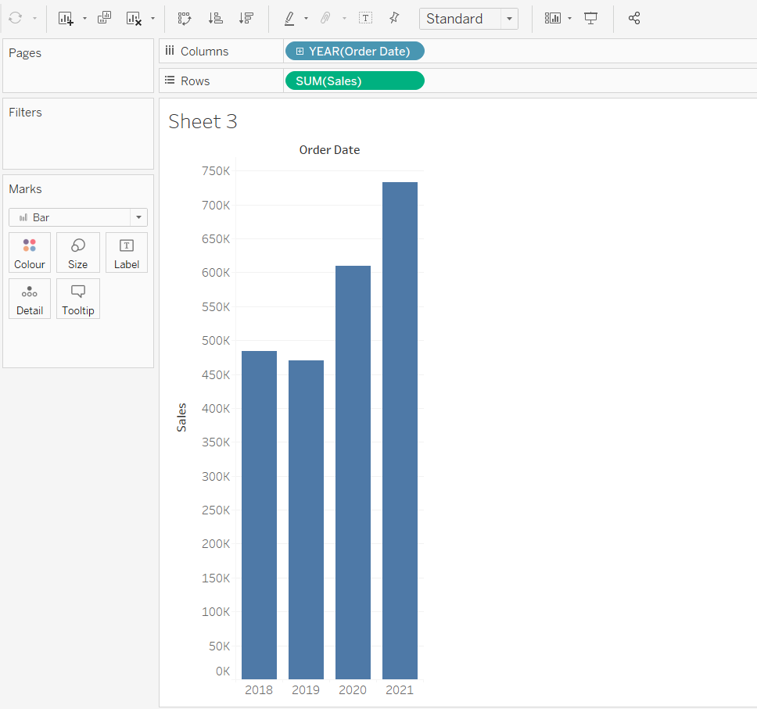
3. show the view in bar graph.

Slide 6
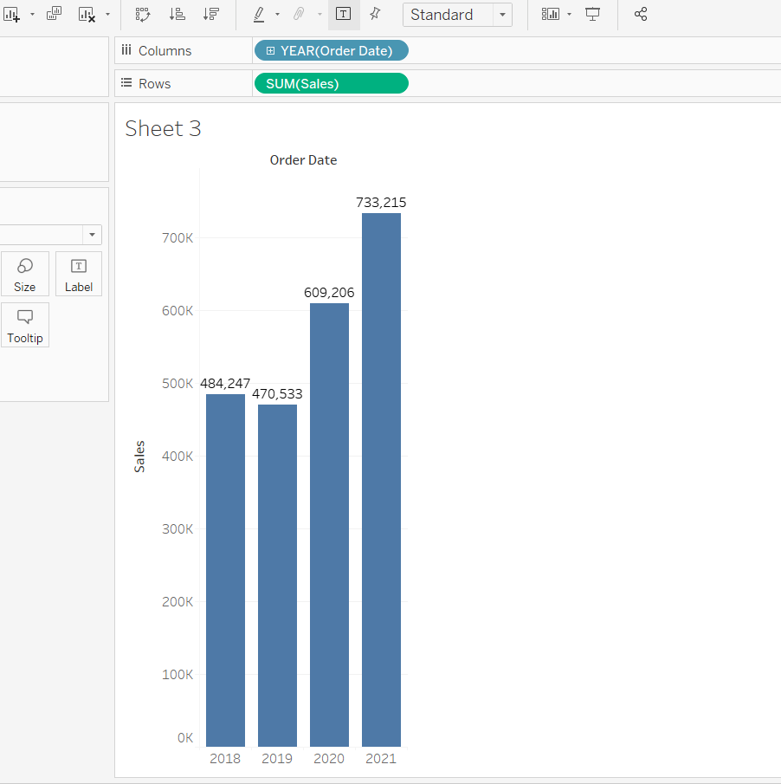
4. Add label to your view.

Slide 7
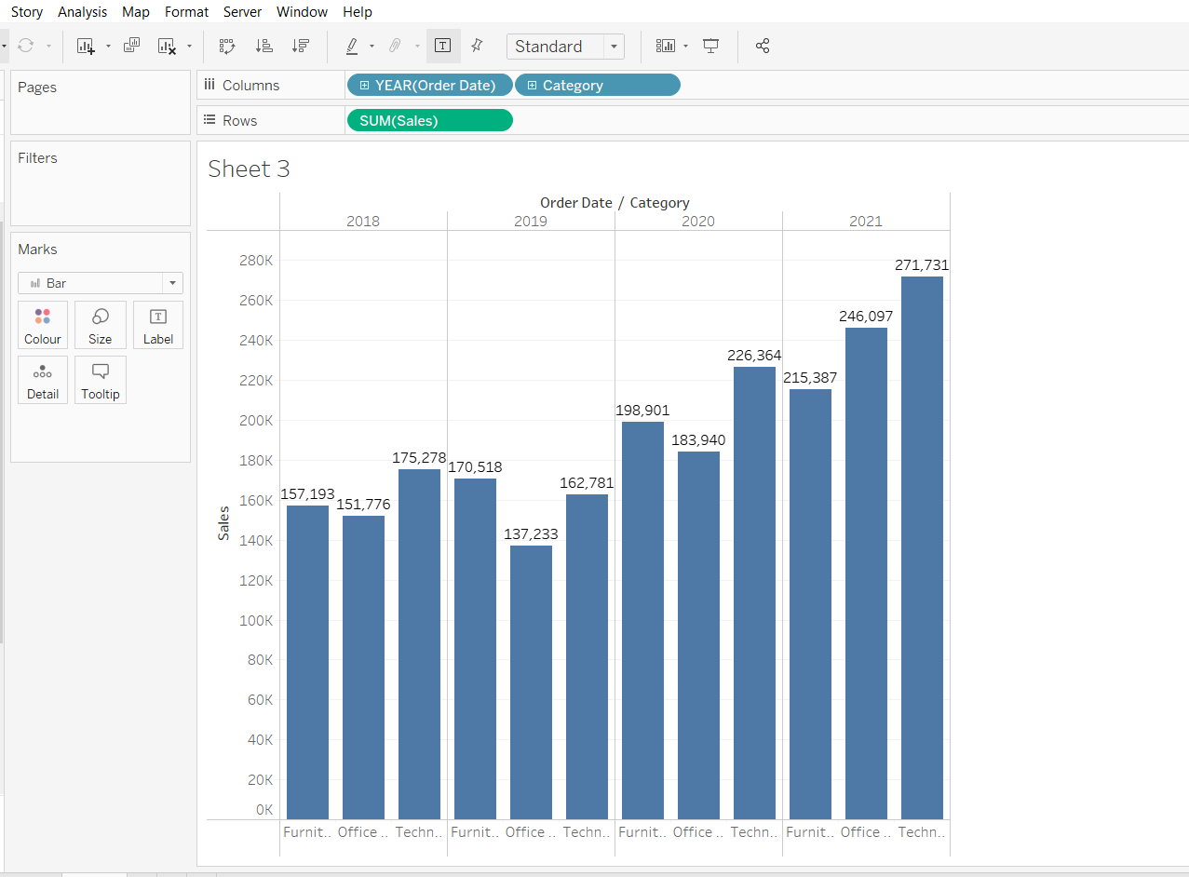
5. Find the category wise sales for every year.

Slide 8
6. Find the category wise sales for every year.
In 2020 → technology
(222,364)
In 2021 → technology
(271,731)

Slide 9
7. Based on the analysis of the year 2020 & 2021. give some suggestions to improve Sales in the year 2022.
→We should be providing more budget to the technology sector as they have the highest sales in both the years i.e in 2020 and 2021.
→We should be going through the overall process of furniture in order to see where we are lacking as it has got the lowest sales in both the years.

Slide 10
8. Display subcategory and find some insights from the view about max and min sales under every category.
We need to check out the reason behind declination in the sales of envelope as in 2021 , it is recorded that the minimum sales i.e 3379 was recorded in the latest year 2021.

Slide 11
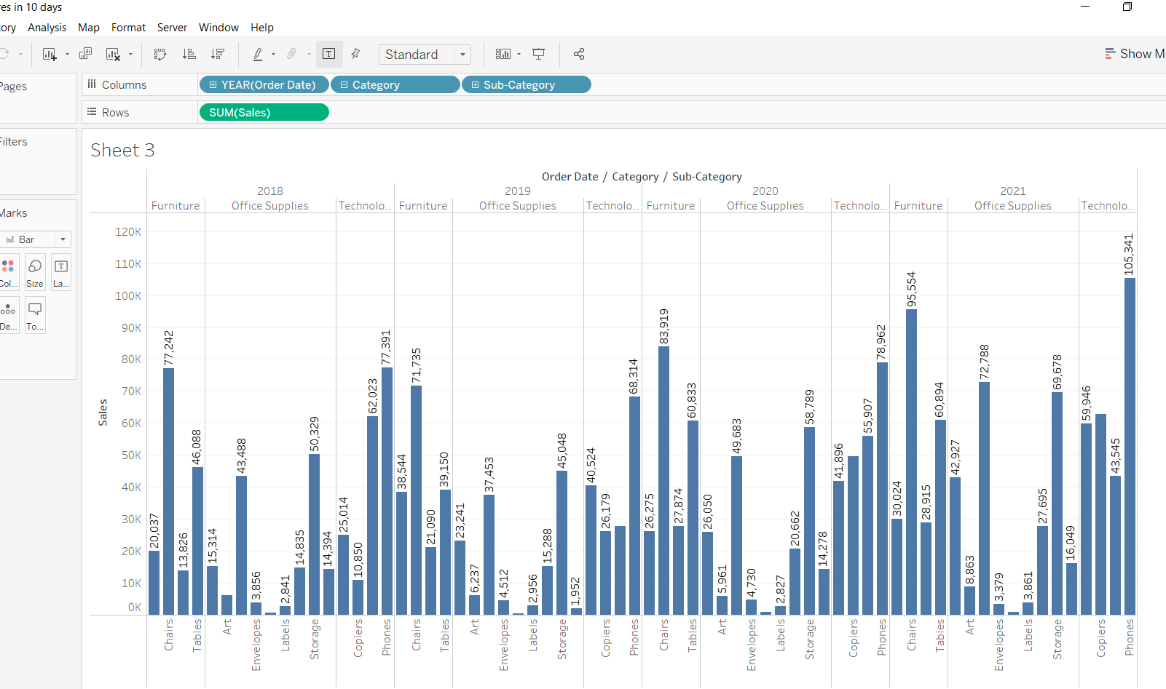

Slide 12
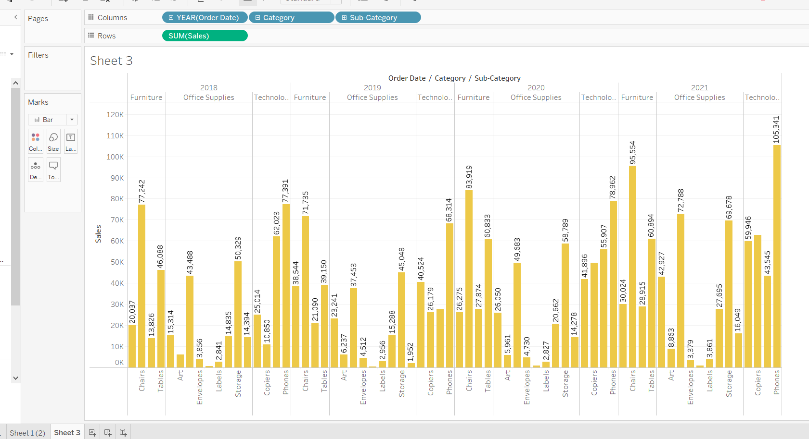
9. Change the color of your visual.

Slide 13
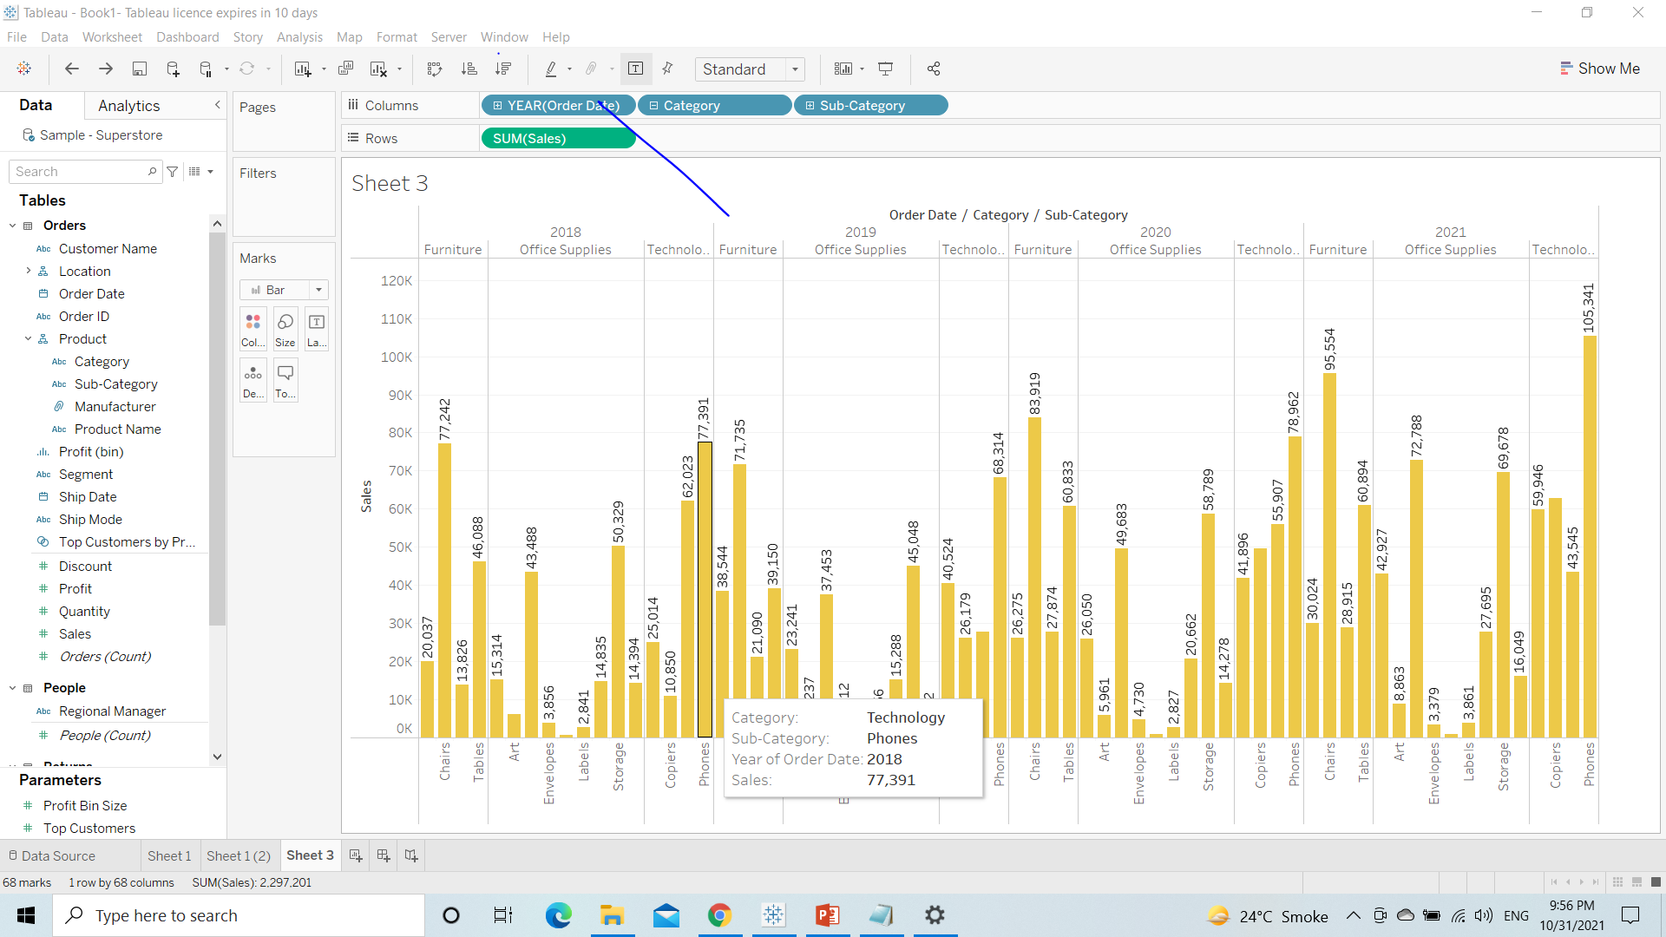
10. Check the Tooltip.

Slide 14
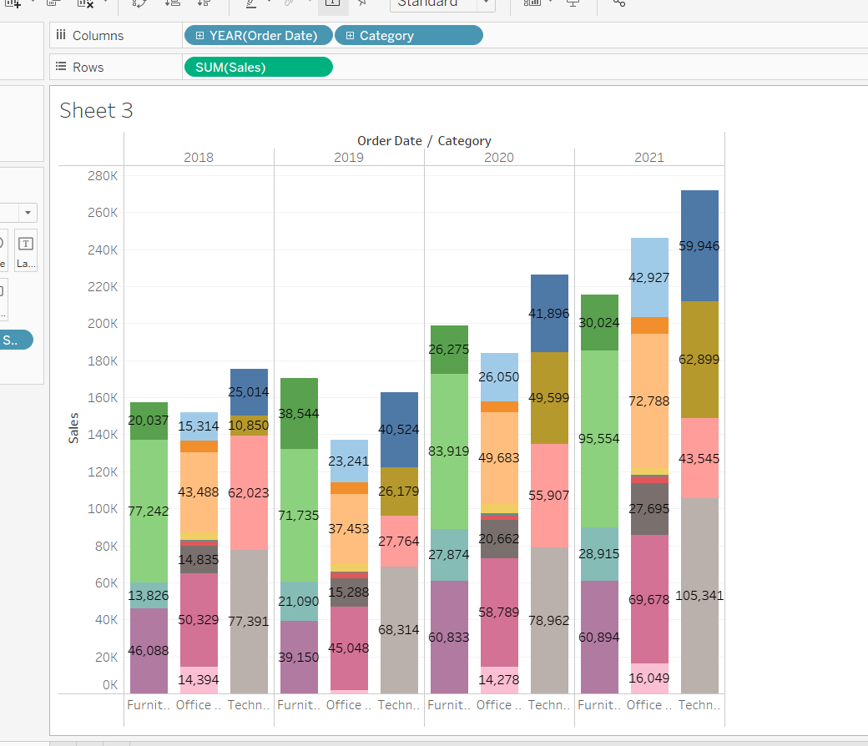
11. In your bar graph, present subcategory under each bar of category using colour card

